Slide 1
Update (Yu)
Merlin* board MA100
Arria 10 GX1150
2-link x16 4GB HMC
Host
HIX
Switch Logic
HMCC
Link#0
Switch
VC #0
…
PCIe Gen3 X8
CMC logic
…
…
…
…
HMCC
Link#1
VC #N
…
C
A
B
F
G
D
E
C
2-link x16 4GB HMC
Host
Black dotted lines: available measurement pts.
A, B: as defined before
F, G: Provided perfmon logic: memory access latency from those points
Green dotted lines: additional target points
E: DRAM delay
D: More dynamic delay (queue, overflow)
C: Somehow measure CMC logic latency
Link#0
Switch
VC #0
…
CMC logic
…
…
…
Link#1
VC #N
…
Notes:
Discuss (explain to me) the “Approach to target delays” bullet

Slide 2
Update (Yu)
Merlin* board MA100
Arria 10 GX1150
2-link x16 4GB HMC
Host
HIX
Switch Logic
HMCC
Link#0
Switch
VC #0
…
PCIe Gen3 X8
CMC logic
…
…
…
…
HMCC
Link#1
VC #N
…
C
A
B
F
G
K
D
E
C
2-link x16 4GB HMC
Host
Yellow dotted line: additional measuring point
G-K: latency caused by HMC controller
Assume logic inside HMC controller consumes constant time
K-D: latency caused by link data transmission
D = G - <G,K> - <K,D>
Link#0
Switch
VC #0
…
CMC logic
…
…
…
Link#1
VC #N
…
Notes:
Discuss (explain to me) the “Approach to target delays” bullet

Slide 3
Update (Yu)
Single mem. operation utilizes only one link
Merlin* board MA100
Arria 10 GX1150
2-link x16 4GB HMC
Host
HIX
Switch Logic
HMCC
Link#0
Switch
VC #0
…
PCIe Gen3 X8
CMC logic
…
…
…
…
HMCC
Link#1
VC #N
…
C
A
B
F
G
K
D
E
K-D latency =
16 lanes
10Gb/s
128 bit/package
Notes:
Discuss (explain to me) the “Approach to target delays” bullet

Slide 4
HMCC
Altera HMC controller
Memory Read
HMCC wraps read address, adding header and tail
Wait until data of accessed address is returned
Memory Write
HMCC wraps write address and write data, adding header and tail
Wait until write valid signal is asserted
Data interface width = 512 bits
Reading/writing data, width > 512bits, needs multiple cycles

Slide 5
HMCC (contd.)
Altera HMC controller
No documentation about logic inside Altera HMC controller, guess:
Queue/FIFO
Consecutive memory access will cause latency if buffer is full
Doesn’t matter with single memory read/write
Simple combinational logic to add header and tail
Determine memory read/write
For single memory operation, latency between G and K can be regarded as a small constant value, ignorable

Slide 6
Memory Read
Memory write is similar
Request header (64bit)
ADRS[33:0]: address to access
CMD[5:0]: operation mode
Request tail (64bit)
Memory read request
Memory read response (e.g. return 32B data)
CUB[2:0] | RES[2:0] | ADRS[33:0] | TAG[8:0] | DLN[3:0] | LNG[3:0] | RES | CMD[5:0]
64bit
Tail | Header
Data[63:0] | Header
Data[191:128] | Data[127:64]
Tail | Data[255: 192]

Slide 7
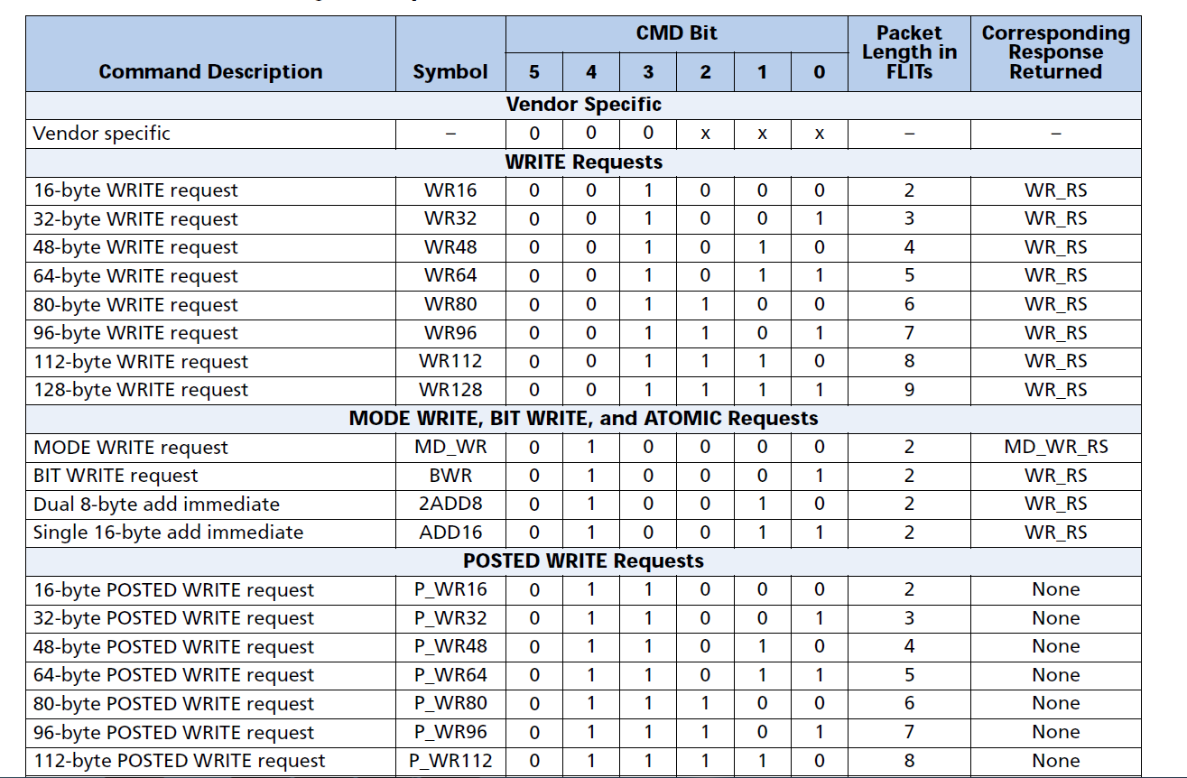
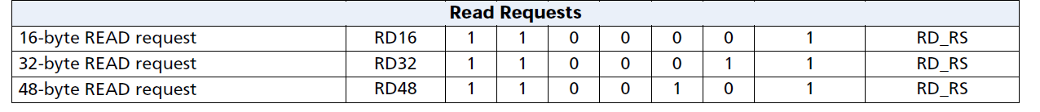
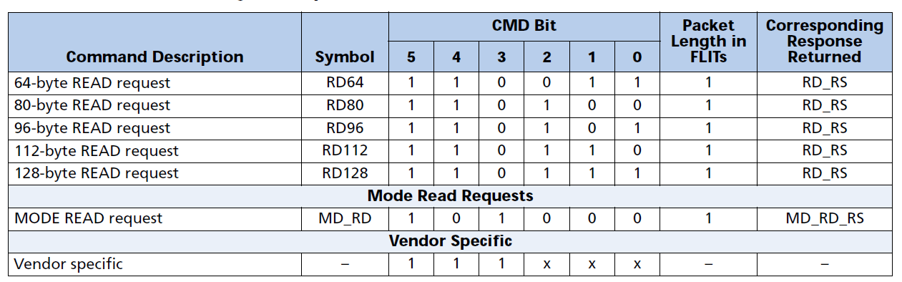
Update (Yu)
K-D latency =
CUB[2:0] | RES[2:0] | ADRS[33:0] | TAG[8:0] | DLN[3:0] | LNG[3:0] | RES | CMD[5:0]

Slide 8
Update (Yu)
Problems
For 64bit single memory operation, we don’t know how CMD[5:0] is configured
Hope Glen or Micron engineers could give some help
Data about Altera HMCC
If not, latency can be ignored for single memory operation
In the future, for complex operations, latency caused by buffer cannot be ignored

